Slide 1
American Tower
Buy: $AMT |Price Target : $330 | Upside : 21%|
Real Estate Sector
11/15/2021
Sector Head: Brandon Wexler
Senior Analyst: Christopher Hui
Junior Analysts: William Hofving & Skylar Kabatsky
1

Slide 2
Agenda
Company Profile
Industry Analysis
Investment Thesis
Catalysts
Valuation
Risks and Mitigants
2

Slide 3
Company Profile
Company Overview
Key Information
A REIT is a company that owns, operates, or finances income-generating real estate
Modeled after mutual funds, REITs pool the capital of numerous investors, making it possible for individual investors to earn dividends from real estate investments—without having to buy, manage, or finance any properties themselves
American Tower Corporation the largest publicly traded real estate investment trust in the US and a leading owner, operator and developer of multitenant communications real estate
AMT owns a global portfolio of 181,000 cell towers, including 41,000 sites in the US, 75,000 sites in India and sites scattered across Europe, South and Central America and Africa
Share Price (11/12/2021)
$272.10
52 Week Range
$197.50 - $303.72
Market Cap.
$123.92B
Enterprise Value
$162.78B
Beta
0.79
CEO
Tom Bartlett
Revenue Breakdown By Region
$AMT vs $SPY
Overview| Thesis |Catalysts|Valuation| Risks and Mitigants
3

Slide 4
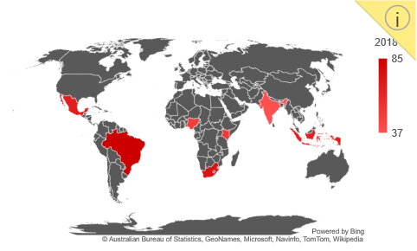
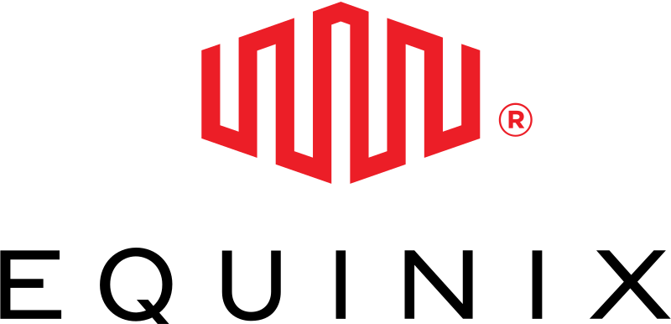
Industry Analysis
Next-Gen Connectivity
Customer Metrics
4G and 5G connectivity creating high performing services to customers
Carriers preparing to deploy more equipment across the nation in areas of weak connectivity
Emerging markets in India as they transition from 2G to 4G technology
Total 5G Coverage
N.A. 5G Coverage
N.A. LTE Coverage
280M
230M
440M
Emerging Markets - Smartphone Connectivity
Source: Pew Research
2018
Competitors
% of people between 18-24
Overview| Thesis |Catalysts|Valuation| Risks and Mitigants
4

Slide 5
Investment Thesis
Data Usage Expansion
The rollout of 5G will fuel growth and improve returns on invested capital through customer's investment in new spectrum assets
Data usage is growing at a rapid rate and this will result in greater demand for AMT’s towers
Low churn rates and long term noncancellable leases with fixed rent escalations and reputable clients provides investors certainty in receiving dividends
5G Network Growth
Predictable Cash Flow
Overview| Thesis |Catalysts|Valuation| Risks and Mitigants
5

Slide 6
Catalyst 1- 5G Network Growth
Global Markets
Spending on 5G by Tenants
5G – the fifth generation of wireless network and connectivity technology, is currently being deployed in network infrastructures globally
American Tower is focusing efforts into expanding its properties and offerings to global markets, where 4G/5G infrastructure requires significant investment
Tenants:
Increase CapEx on 5G infrastructure, more technology installed on AMT towers
Impact on American Tower:
Increase Operating Income Yield
Increase Return on Invested Capital
Global 5G Rollout as of June 2021
Requirements for Tower Infrastructure
Installation of 5G infrastructure will not be a quick process, it could take 5 to 10 years to make the transition from 4G to 5G completely
Will likely be a lot of infrastructure focused on serving mid-band spectrum 5G, faster than 4G LTE and better reach than high band 5G
Spending by tenants will continue to increase over the next few years as more towers will be needed
Overview| Thesis |Catalysts|Valuation| Risks and Mitigants
6

Slide 7
Catalyst 2 – Data Usage
Usage Expansion
AMT’s Position in Market
Mobile data usage has accelerated in the last five years as more people use smartphones, laptops, social media, and videoconferencing.
These trends have intensified with the onset of the COVID-19 pandemic
Data usage in the U.S. has roughly doubled every two years and analysts expect worldwide usage rates to double to over 160 zettabytes by 2025
Consumers and enterprises are using more advanced devices for more things, resulting in consistent elevated growth in mobile data usage which in turn strains existing networks and necessitates improvement
Acquired a significant number of towers since 2016 from 100k to now over 181k
Large presence in Asia with estimates that 1.8Bn people will connect to mobile services
Increase future scale in Europe as usage rates will have a CAGR of 25% for the next 5 years
Data Usage Worldwide (*In zettabytes)
AMT - Owned Towers By Region
Source: Statistica
CAGR: 29.60%
Overview| Thesis |Catalysts |Valuation| Risks and Mitigants
7

Slide 8
Catalyst 3- Stable and Predictable Income
Stable Leases
Predictable Recurring Cash Flows
AMT leases are long-term with built-in contractual rent escalations
Rent escalations are based on a fixed escalation percentage (averaging around 3% in the U.S.), an inflation index (in international markets), or a combination of both
Leases are typically for a non-cancellable initial term of five to ten years with multiple renewal terms
$2.53/share
13.3% Growth
$2.29/share
Low Churn Rates
Strong tenant base with clients such as AT&T, Verizon, and T-Mobile
Historically, the company has kept a 98-99% annual renewal rate based on property revenue, reflecting the limited alternative that tenants must choose from
Cheaper for carriers to outsource communications site infrastructure needs rather than building tower sites
63.2% margin
19.5% Growth
64.5% margin
Overview| Thesis |Catalysts|Valuation| Risks and Mitigants
8

Slide 9
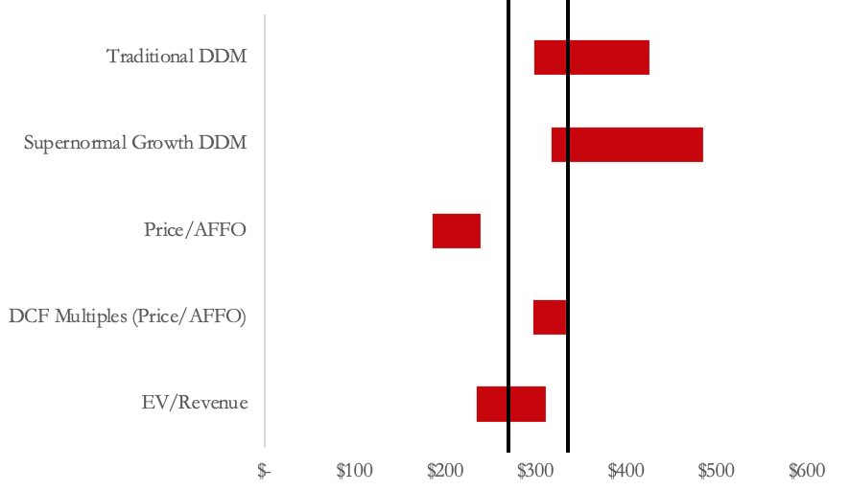
Valuation
Weights
$272
$330
Current Price
Target Price
Upside
$272
$330
21%
Overview| Thesis |Catalysts|Valuation| Risks and Mitigants
9

Slide 10
Risks and Mitigants
Risks
Mitigants
Rising Interest Rates & Inflation
Long term contracts established with built-in rent escalations create a consistent revenue stream
Limited Growth Opportunities in the United States
Largest international exposure; heavy expansion into Asia, European, and South American markets
Leverage Concerns After Recent Acquisitions
Lowest cost of debt at 4% in industry with higher EBITDA margins coming from international expansion
Overview| Thesis |Catalysts|Valuation| Risks and Mitigants
10

Slide 11
Thank You! Questions?
BUY: $AMT| Price Target: $330 | Upside 21%

Slide 12
Appendix
Appendix A: Environmental Impacts
Appendix B: Balance Sheet
Appendix C: Income Statement
Appendix D: Cash Flow Statement
Appendix E: AFFO Calculation
Appendix F: Revenue Build
Appendix G: NWC
Appendix H: Comps
Appendix: I: DDM
Appendix J: DCF
Appendix K: WACC

Slide 13
A: Environmental Impacts
2018
2019
2020
2018
2019
2020
8

Slide 14
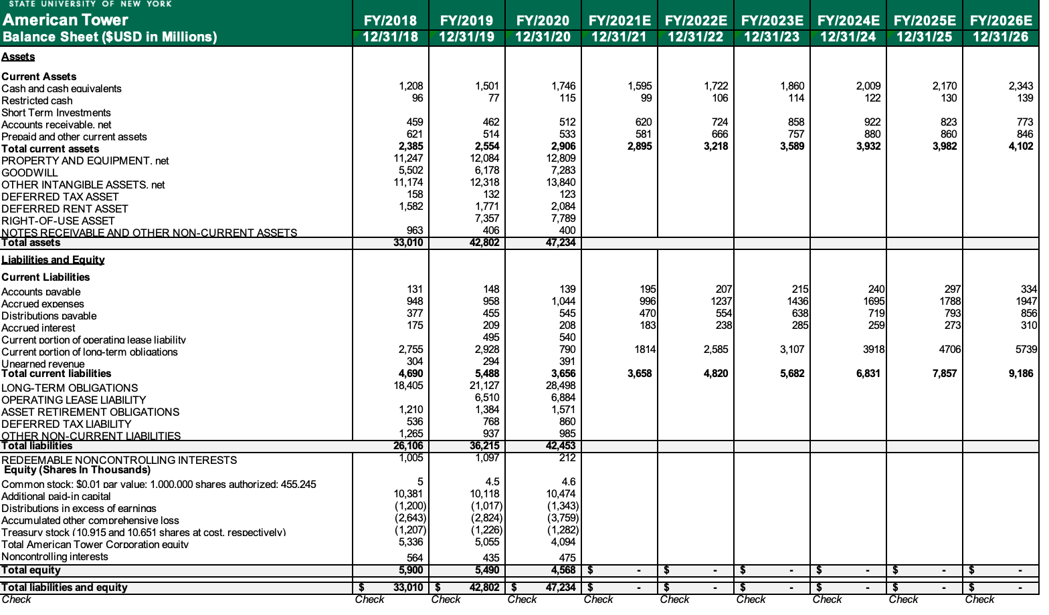
B: Balance Sheet
8

Slide 15
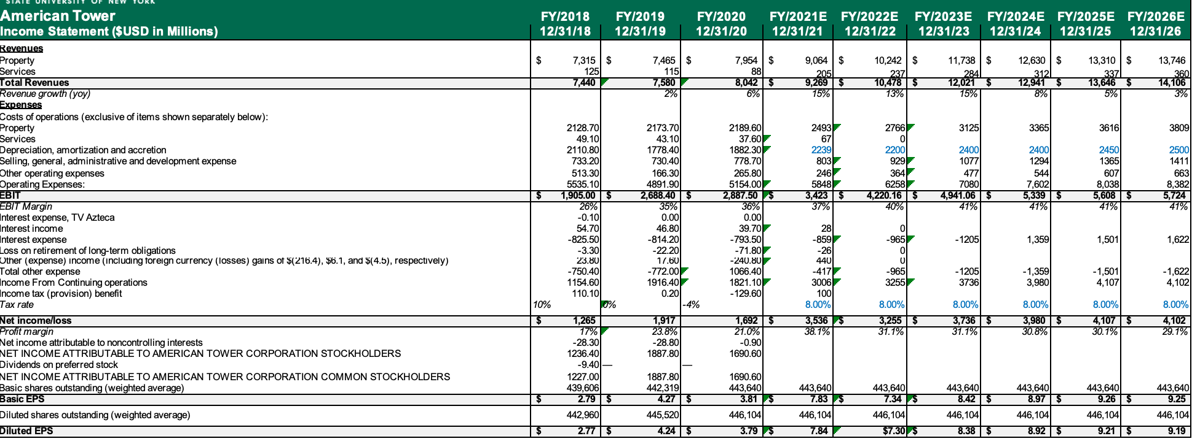
C: Income Statement
8

Slide 16
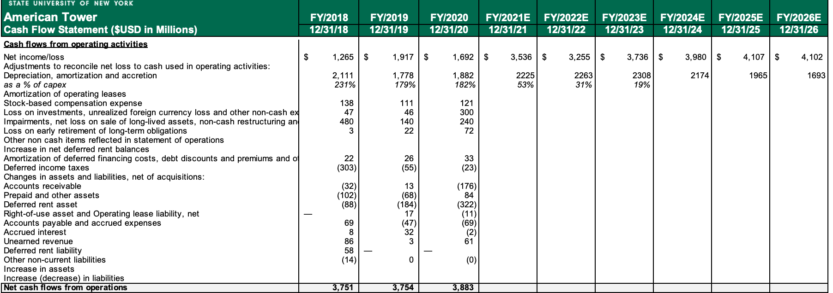
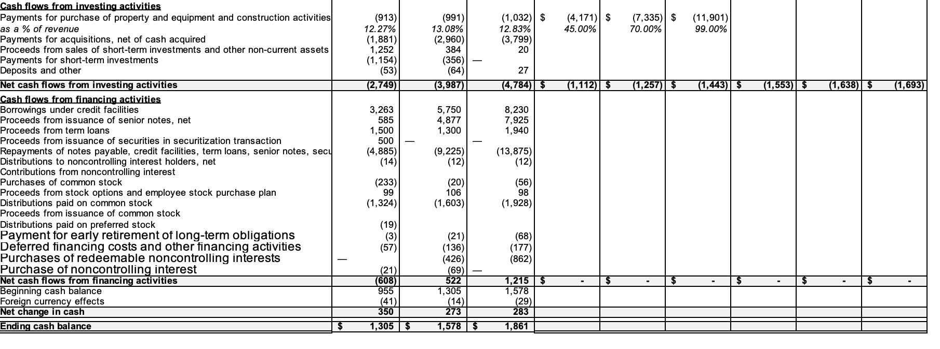
D: Cash Flow Statement
8

Slide 17
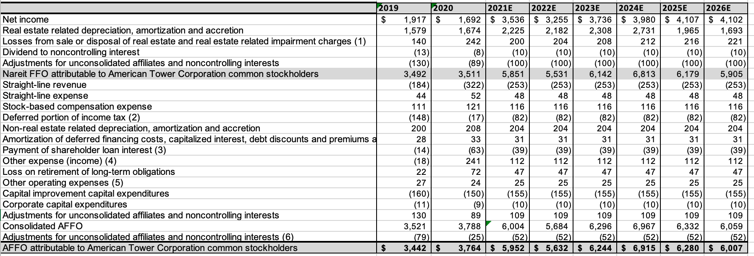
E: AFFO Calculation
8

Slide 18
F: Revenue Build
8

Slide 19
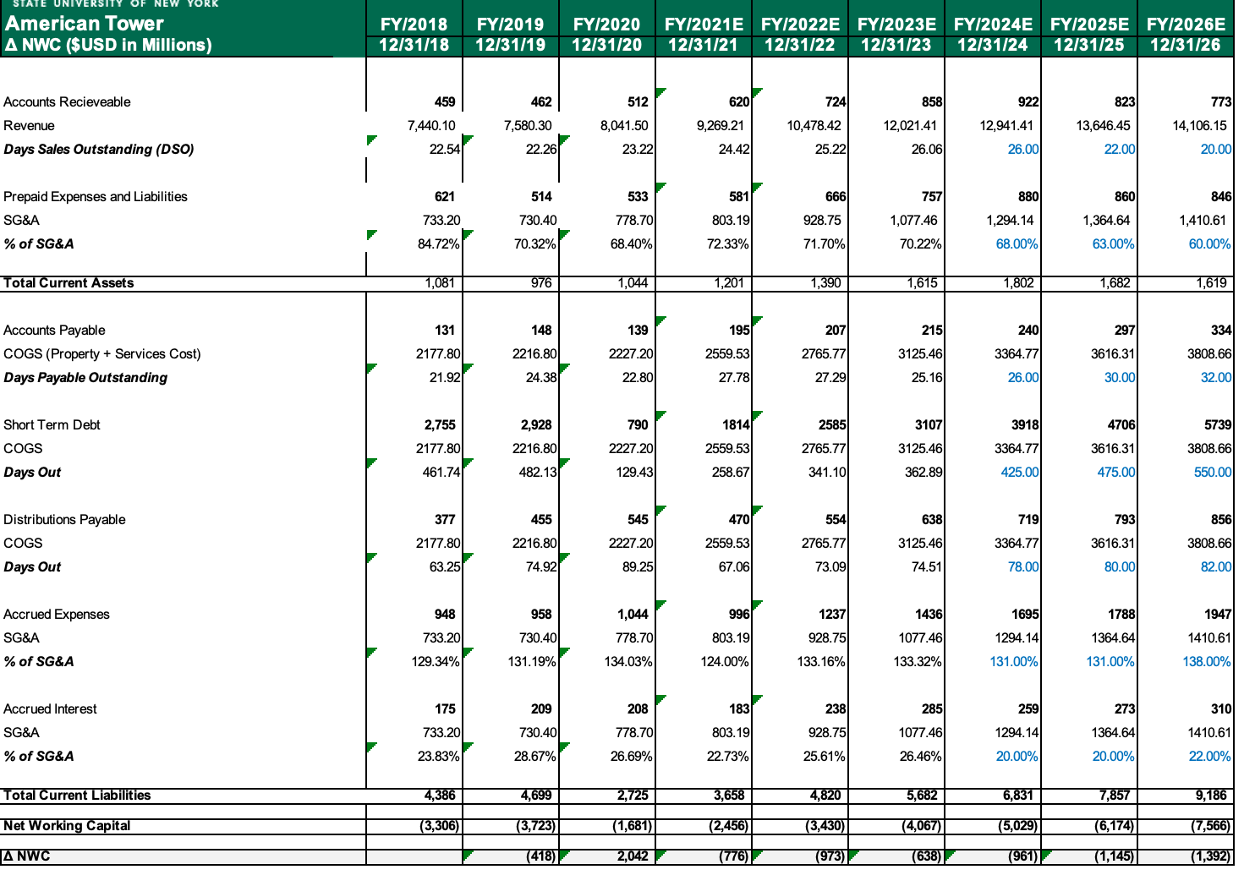
G: NWC
8

Slide 20
H: Comps
8

Slide 21
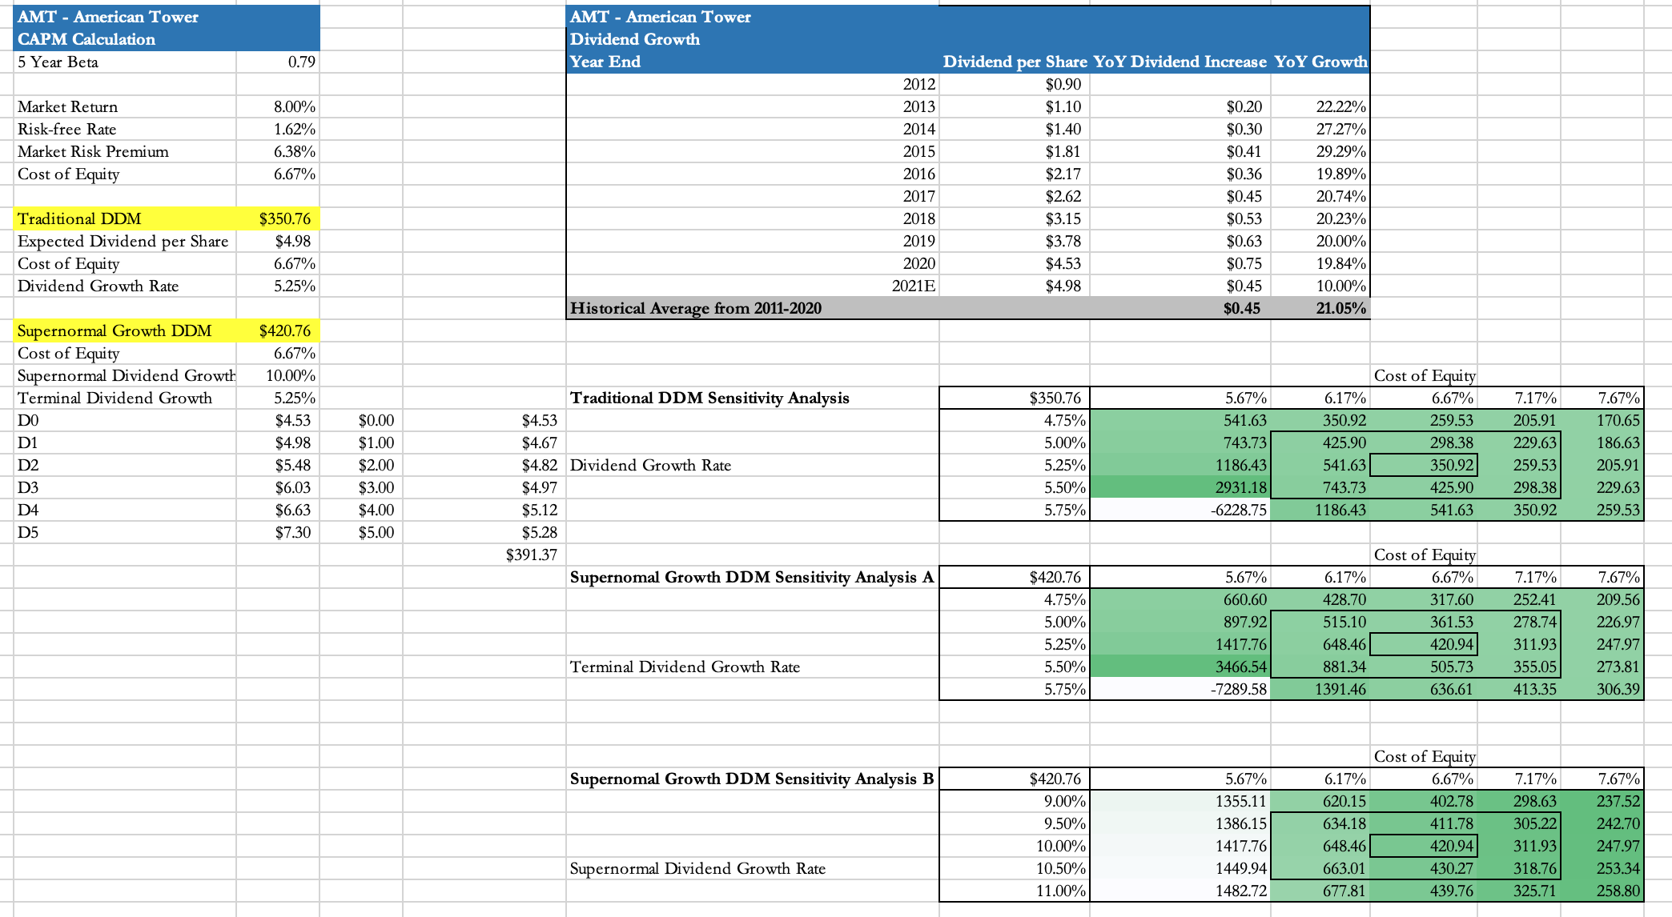
I: DDM
8

Slide 22
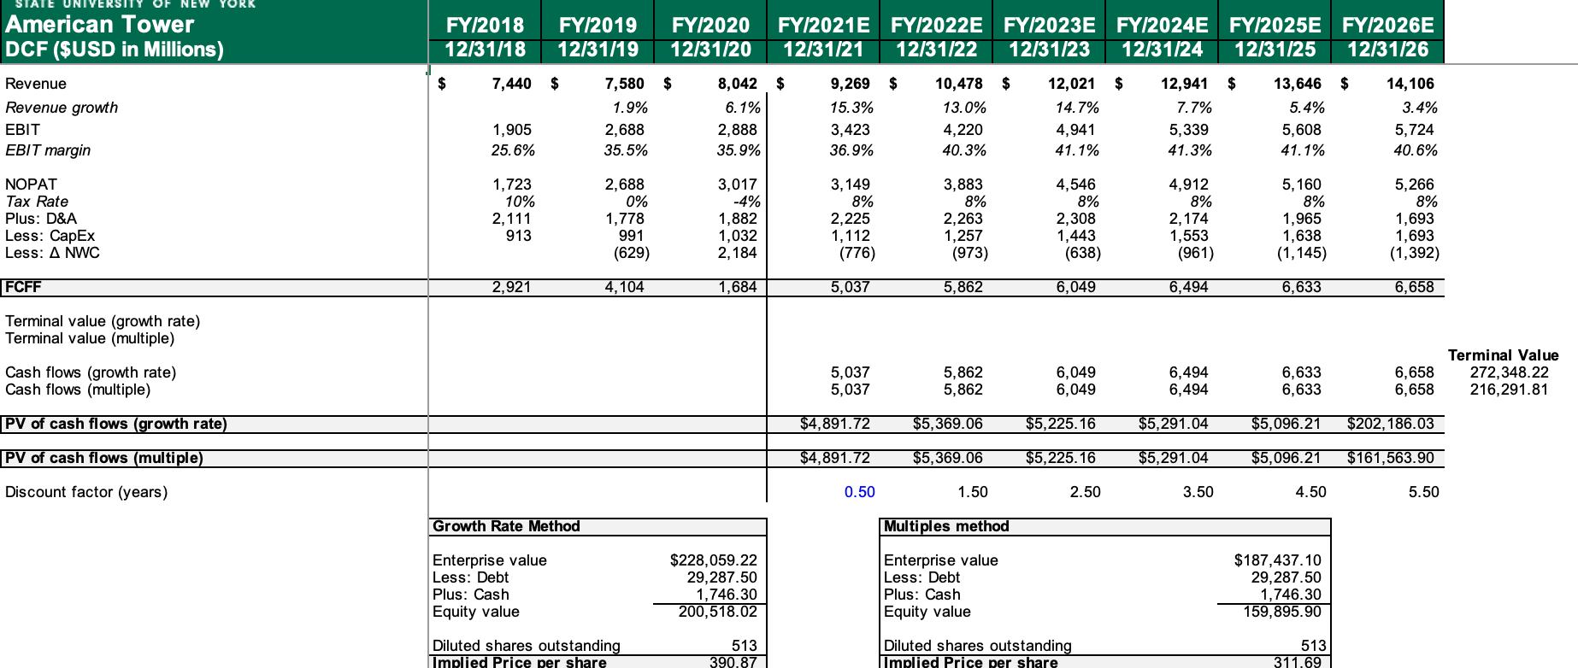
J: DCF
8

Slide 23
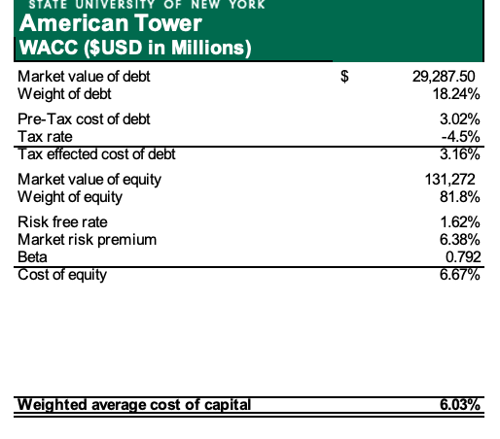
K: WACC
8

